Slide 1
Weather Forecaster

Slide 2

INTRODUCTION
Weather forecasting is the process of using science and technology to predict the conditions of the atmosphere—like rain, sunshine, wind, and temperature—for a specific place and time.

Slide 3
WHY IT MATTERS?
Agriculture: Farmers rely on weather data for planting and harvesting.
Travel: Helps avoid disruptions due to bad weather.
Disaster Preparedness: Early warnings for storms, floods, and heatwaves save lives.
The demand for accurate, real-time predictions is rising due to climate change and global urbanization.

Slide 4
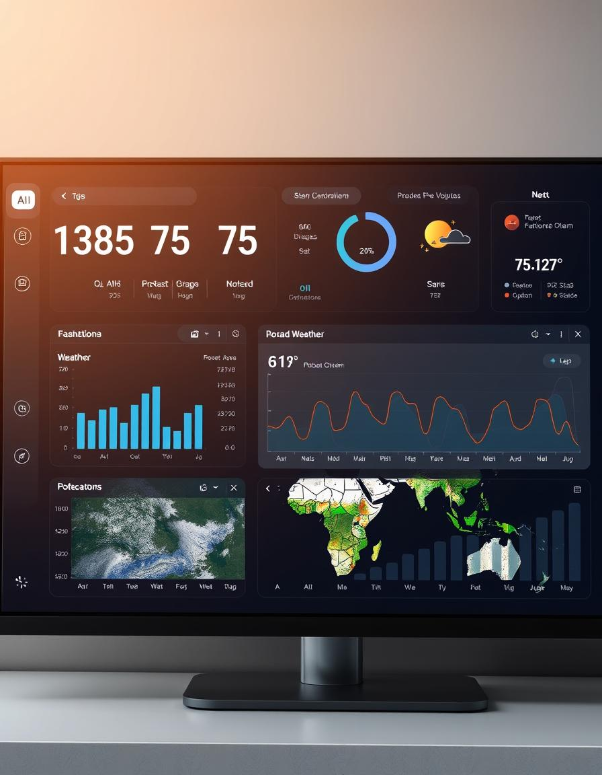
OBJECTIVES
Speed Up Data Processing
Process vast amounts of
weather data rapidly.
Provide interactive input options for users to select between current weather and forecast views.
Retrieve real-time current weather data for any city.
Visualize 5-day weather forecasts using temperature, humidity, and precipitation data.

Slide 5
HOW IT WORKS?
API CALL
AI ANALYSIS
FORECAST OUTPUT
INPUT(CITY)
INPUT(CITY)

Slide 6
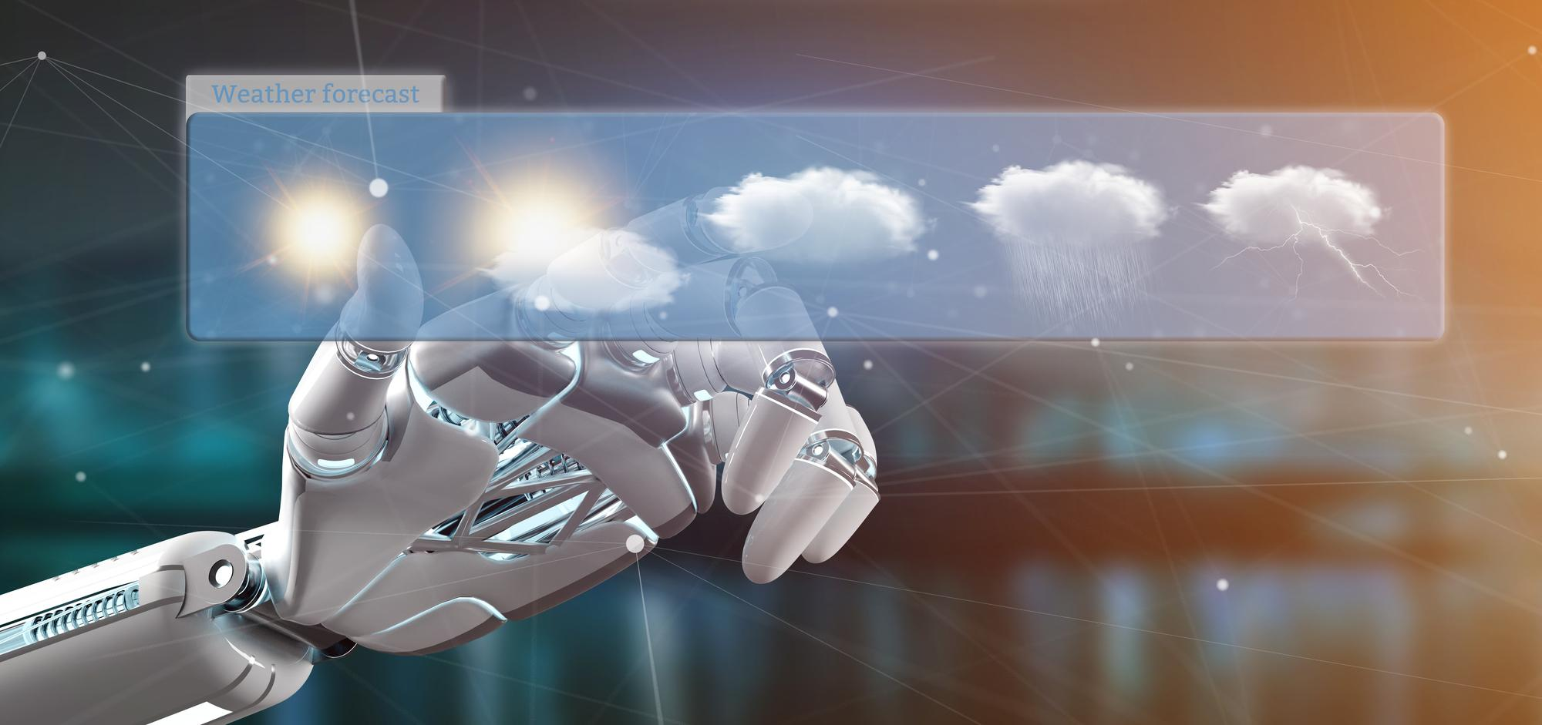
ADVANTAGES
Faster and More Accurate Predictions
Handling Complex Data from Multiple Sources
Better Forecasts for Remote or Underrepresented Areas
Cost-Effective and Scalable
Learning from the Past

Slide 7
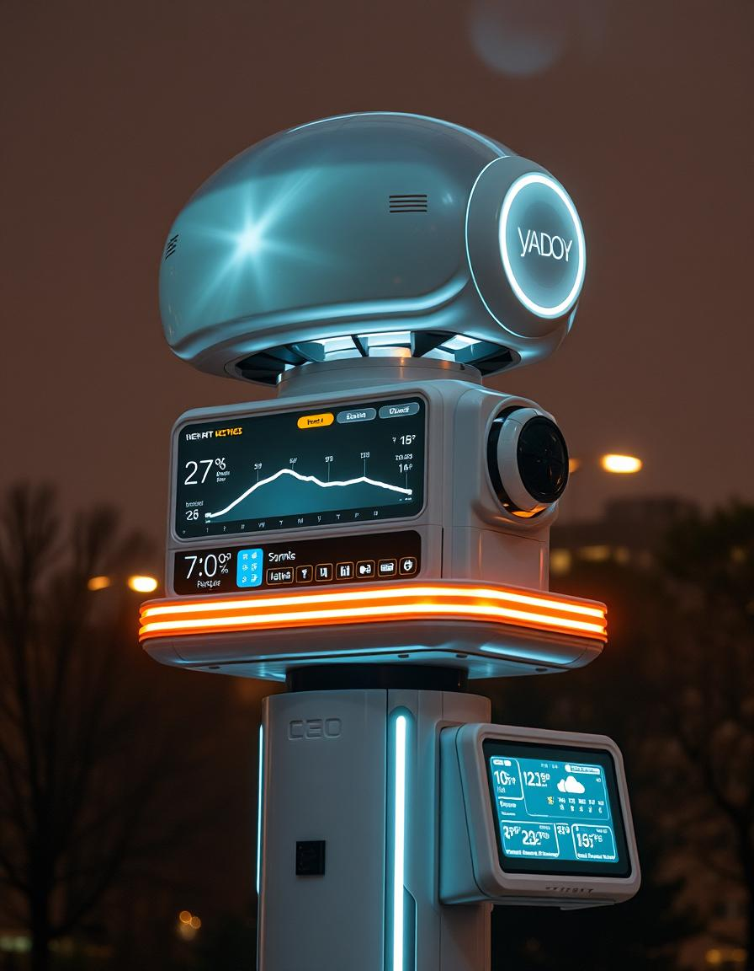
FUTURE SCOPE
Smart Weather Alerts and Notifications
AI-Based Outfit or Activity Suggestions
Smart Home Integration
Add Geolocation-Based Auto Detection

Slide 8
CONCLUSION
AI Weather Forecaster brings together the power of artificial intelligence and real-time weather data, making it easier for you to stay informed with accurate and helpful weather updates.
Easy to use
Reliable
Adaptable
Socially impactful

Slide 9
THANK YOU

